Slide 1
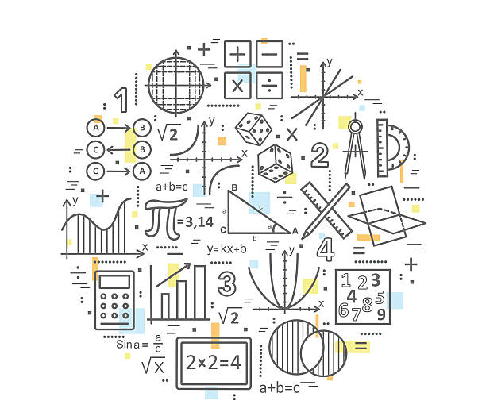
Welcome To Liberal Arts Math II
Review class information handout & schedule.
Note any questions you have on course, schedule, etc.

